Slide 1
IBM Applied Data Science Capstone
Opening a New Indian Restaurant in Missisauga, Canada
By Sameer Pradeep
March 2020

Slide 2
Business Problem
Location of the Indian Restaurant is one of the most important decisions that will determine whether it will be a success or a failure.
Objective: To analyse and select the best locations in the city of Mississauga, Canada to open a Indian restaurant.
Business question
➢In the city of Missussauga, if a property developer is looking to open a new Indian Restaurant, where would you recommend that they open it?

Slide 3
Data
Data required
➢List of neighbourhoods in Mississauga
➢Latitude and longitude coordinates of the neighbourhoods
➢Venue data, particularly data related to Indian restaurants
• Sources of data
➢Wikipedia page for neighbourhoods
(https://en.wikipedia.org/wiki/Category:Neighbourhoods_in_Mississauga)
➢Geocoder package for latitude and longitude coordinates
➢Foursquare API for venue data

Slide 4
Methodology
Web scraping Wikipedia page for neighbourhoods list
Get latitude and longitude coordinates using Geocoder
Use Foursquare API to get venue data
Group data by neighbourhood and taking the mean of the frequency of occurrence of each venue category
Filter venue category by Shopping Mall
Perform clustering on the data by using k-means clustering
Visualize the clusters in a map using Folium

Slide 5
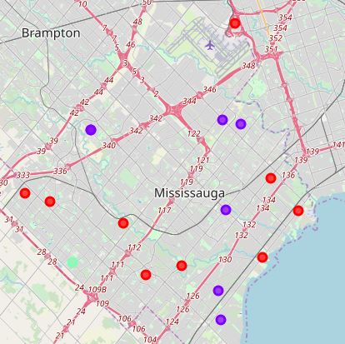
Results
Categorized the neighbourhoods
into 3 clusters :
➢Cluster 0: Neighbourhoods with high concentration of Indian restaurants
➢Cluster 1: Neighbourhoods with moderate number of Indian restaurants
➢Cluster 2: Neighbourhoods with low number to no existence of Indian restaurants

Slide 6
Discussions
Highest number in cluster 0 and moderate number in cluster 1
Cluster 2 has very low number to no shopping mall in the neighbourhoods

Slide 7
Recommendations
Open Indian in neighbourhoods in cluster 2 with little to no competition.
Can also open in neighbourhoods in cluster 1 with moderate competition if have unique selling propositions to stand out from the competition
Avoid neighbourhoods in cluster 0, already high concentration of Indian restaurants and intense competition

Slide 8
Conclusion
Answer to business question: The neighbourhood of Churchill Meadows in cluster 2 is the most preferred location to open a new Indian restaurant.
Findings of this project will help the relevant stakeholders to capitalize on the opportunities on high potential locations while avoiding overcrowded areas in their decisions to open a new Indian Restaurant.

Slide 9
THANK YOU!!!!!!!!

